Slide 1
Hash-Based Indexes
Jianlin Feng
School of Software
SUN YAT-SEN UNIVERSITY

Slide 2
Introduction
As for any index, 3 alternatives for data entries k*:
  Data record with key value k
  <k, rid of data record with search key valuek>
  <k, list of rids of data records with search key k>
  Choice orthogonal to the indexing technique
Hash-based indexes are best for equality selections. Cannot support range searches.
Static and dynamic hashing techniques exist; trade-offs similar to ISAM vs. B+ trees.

Slide 3
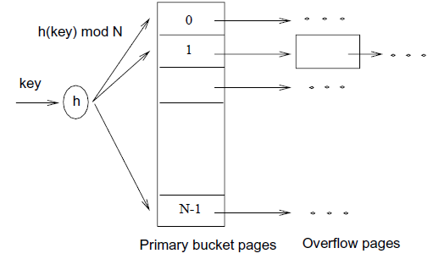
Static Hashing
The number of primary pages is fixed.
Primary pages are allocated sequentially, never de-allocated;
  overflow pages if needed.
h(k) mod N = bucket to which data entry with key k belongs. (N = number of buckets)

Slide 4
Static Hashing (Contd.)
Buckets contain data entries.
Hash function works on search key field of record r. Must distribute values over range 0 ... N-1.
  h(key) = (a * key+ b) usually works well.
  a and b are constants; lots known about how to tune h.
Long overflow chains can develop and degrade performance.
  Extendible and Linear Hashing: Dynamic techniques to fix this problem.

Slide 5
Extendible Hashing
Situation: Bucket (primary page) becomes full. Why not re-organize file by doubling the number of buckets?
  Reading and writing all pages is expensive!
Idea of Extendible Hashing:
  Use directory of pointers to buckets, double the number of buckets by doubling the directory,
  splitting just the bucket that overflowed!

Slide 6
Extendible Hashing (Contd.)
Directory is much smaller than file, so doubling it is much cheaper.
Only one page of data entries is split. No overflow page!
Trick lies in how hash function is adjusted!

Slide 7

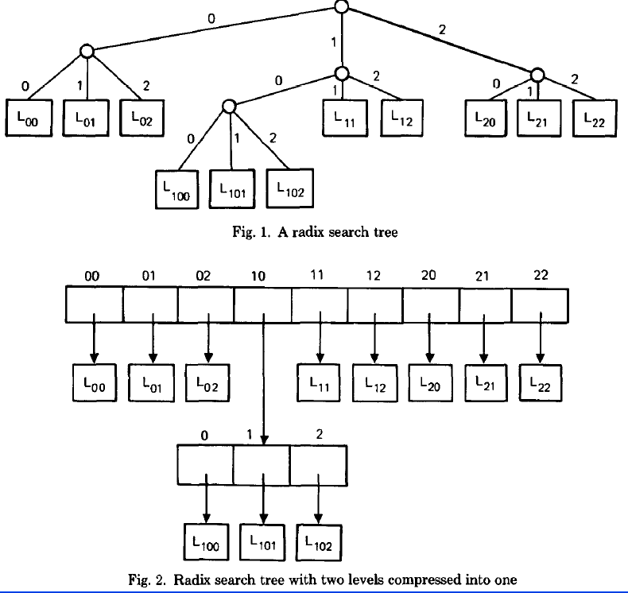
Extendible Hashing Equals Balanced Radix Search Trees (1)

Slide 8
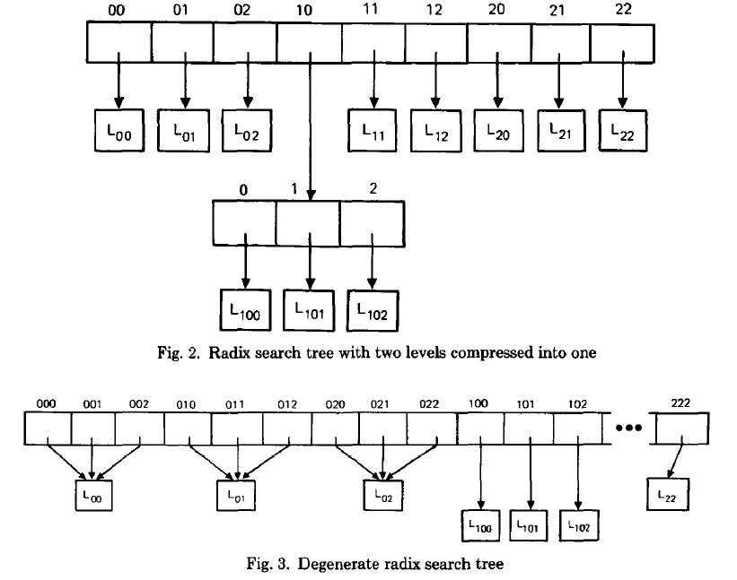
Extendible Hashing Equals Balanced Radix Search Trees (2)

Slide 9
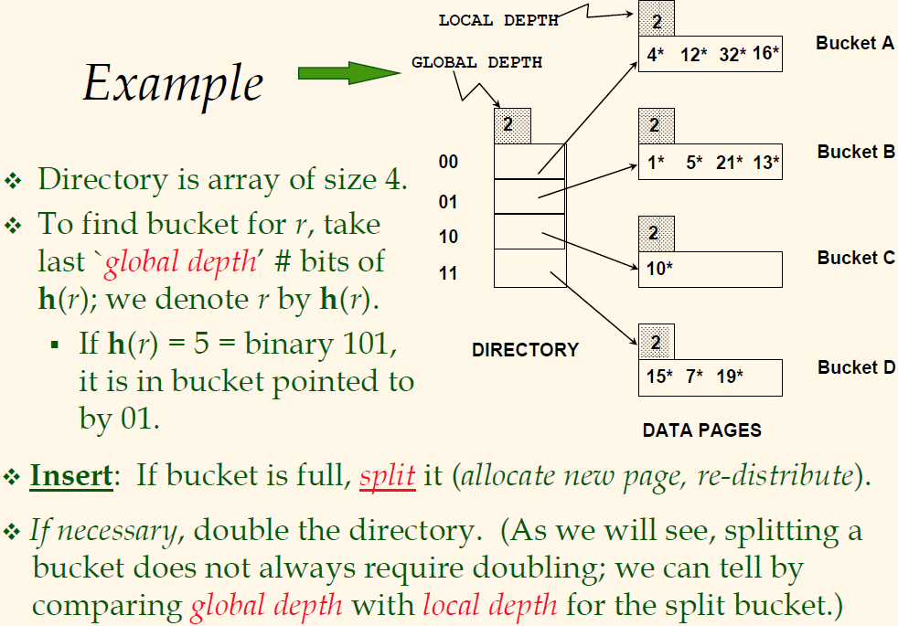

Slide 10
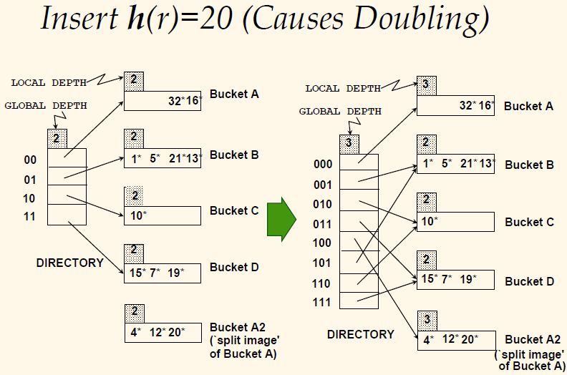

Slide 11
Points to Note
20 = binary 10100. Last 2 bits (00) tell us r belongs in A or A2. Last 3 bits needed to tell which.
  Global depth of directory: Max number of bits needed to tell which bucket an entry belongs to.
  Local depth of a bucket: number of bits used to determine if an entry belongs to this bucket.
When does bucket split cause directory doubling?
  Before insert, local depth of bucket = global depth. Insert causes local depth to become > global depth.

Slide 12
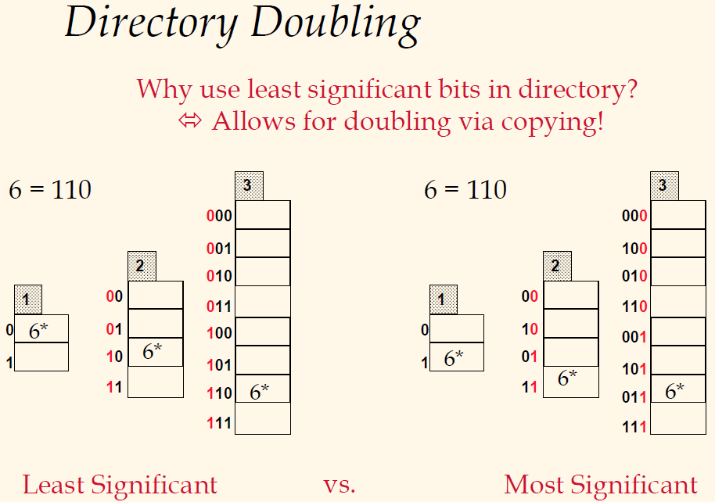

Slide 13
Equality Search in Extendible Hashing
If directory fits in memory, equality search answered with one disk access; else two.
  100MB file, 100 bytes/rec, 4K pages contains 1,000,000 records (as data entries) and 25,000 directory elements;
  chances are high that directory will fit in memory.

Slide 14
Delete in Extendible Hashing
If removal of data entry makes a bucket empty, the bucket can be merged with its `split image’.
If each directory element points to same bucket as its split image, we can halve the directory.

Slide 15
Linear Hashing (LH)
This is another dynamic hashing scheme, an alternative to Extendible Hashing.
LH handles the problem of long overflow chains without using a directory, and handles duplicates.
  What problem will duplicates cause in Extendible Hashing?

Slide 16
The Idea of Linear Hashing
Use a family of hash functions h₀, h₁, h₂, ..., where h_{i+1} doubles the range of h_{i} (similar to directory doubling)
  h_{i}(key) = h(key) mod (2^{i}N); N = initial # buckets
  h is some hash function (range is not 0 to N-1)
  If N = 2^{d0}, for some d0, h_{i} consists of applying h and looking at the last di bits, where di = d0 + i.

Slide 17
The Idea of Linear Hashing (Contd.)
Directory avoided in LH by using overflow pages, and choosing bucket to split round-robin.
  Splitting proceeds in `rounds’.
  Round ends when all N_{R} initial (for round R) buckets are split.
  Buckets 0 to Next-1 have been split; Next to N_{R} yet to be split.
  Current round number is Level.

Slide 18
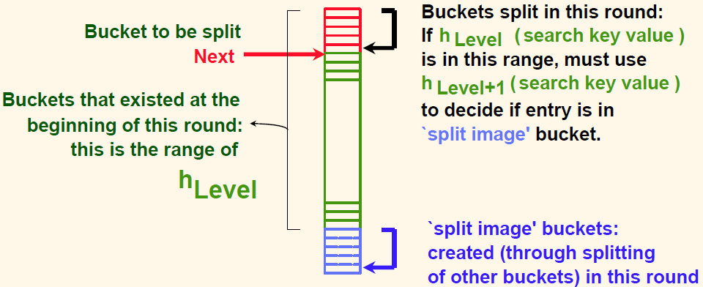
Overview of LH File: in the Middle of the Level –th Round

Slide 19
Search in Linear Hashing
To find bucket for data entry r, find h_{Level}(r):
  If h_{Level}(r) in range `Next to N_{R}’, r belongs here.
  Else, r could belong to bucket h_{Level}(r) or bucket h_{Level}(r) + N_{R}; must apply h_{Level+1}(r) to find out.

Slide 20
Inserting a Data Entry in LH
Find bucket by applying h_{Level}/ h_{Level+1}:
  If the bucket to insert into is full:
    Add overflow page and insert data entry.
    (Maybe) split Next bucket and increment Next.
  Else simply insert the data entry into the bucket.

Slide 21
Bucket Split
A split can be triggered by
  the addition of a new overflow page
  conditions such as space utilization
Whenever a split is triggered,
  the Next bucket is split,
  and hash function h_{Level+1} redistributes entries between this bucket (say bucket number b) and its split image;
  the split image is therefore bucket number b+N_{Level}.
  Next ← Next + 1.

Slide 22
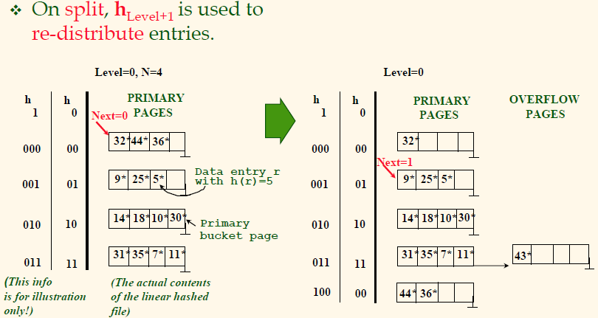
Example of Linear Hashing
Insert data entry of 43*

Slide 23
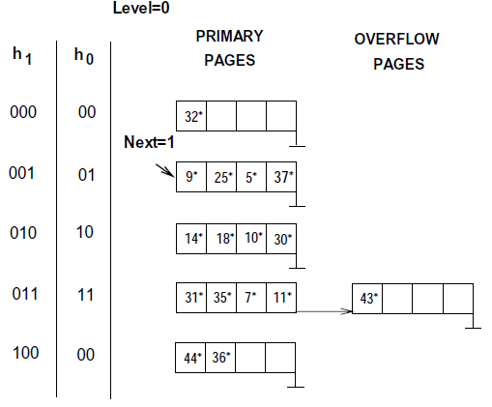
After Inserting Data Entry of 37*

Slide 24
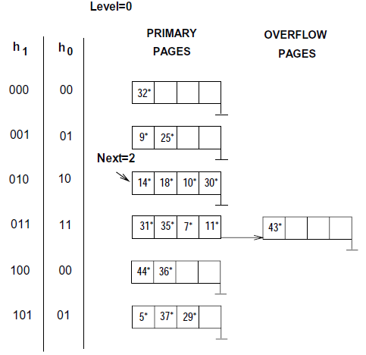
After Inserting Data Entry of 29*

Slide 25
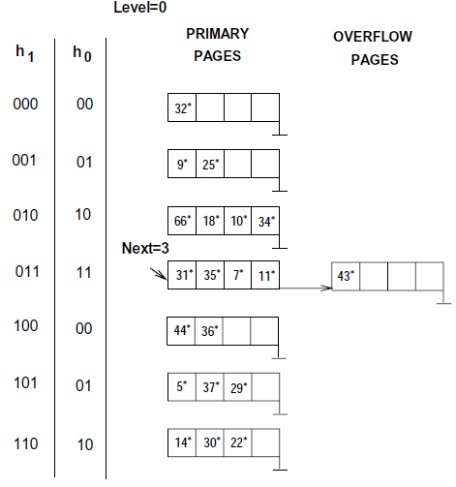
After Inserting Data Entries of 22*, 66* and 34*

Slide 26
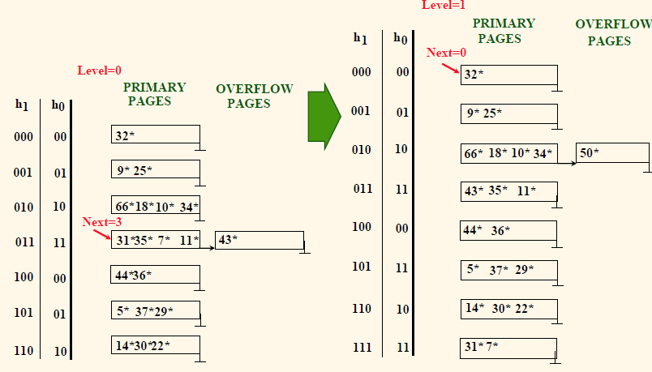
Example: End of a Round, After Inserting Data Entry 50*.

Slide 27
Extendible VS. Linear Hashing
Imagine that we also have a directory in LH with elements 0 to N-1.
  The first split is at bucket 0, and so we add directory element N.
  Imagine directory being doubled at this point, but elements <1,N+1>, <2,N+2>, ... are the same. So, we can avoid copying elements from 1 to N-1.
  We process subsequent splits in the same way,
  And at the end of the round, all the orginal N buckets are split, and the directory is doubled in size.
i.e., LH doubles the imaginary directory gradually.

Slide 28
Summary
Hash-based indexes: best for equality searches, cannot support range searches.
Static Hashing can lead to long overflow chains.
Extendible Hashing avoids overflow pages by splitting a full bucket when a new data entry is to be added to it.
Linear Hashing avoids directory by splitting buckets round-robin, and using overflow pages.

